Slide 1
Interface in Java
Java does not support multiple inheritance as C++ supports
Java supports an alternative approach to this OOP feature known as interface
What is Interface?
An interface is basically a kind of class. Like classes, an interface contains members and methods; unlike classes, in interface all members are final and all methods are abstract

Slide 2
Why use Java interface?
There are mainly three reasons to use interface. They are given below.
It is used to achieve abstraction.
By interface, we can support the functionality of multiple inheritance.
It can be used to achieve loose coupling.

Slide 3
Syntax for Defining an Interface
Following is the syntax to define an Interface
interface interfaceName [extends name1, ..... ]
{
[ Variable(s) declaration;]
[ Method(s) declaration;]
}
Variable in interface is declared as:
static final type varName = value;
Method in interface is declared as:
Retun-type methodName(parameter list);

Slide 4
Defining an Interface: Examples
Example 1
interface anItem
{
static final int code = 101;
static final String itemName = “Computer”
void recordEntry( );
}
Example 2
interface curves extends circle, ellipse
{
static final float pi = 3.142F;
float area(int a, int b);
void print( );
}

Slide 5
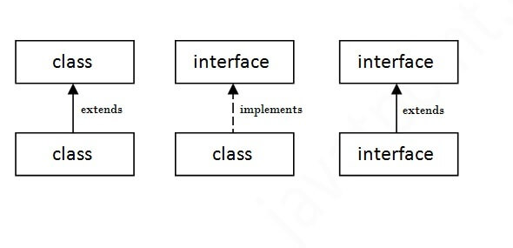
The relationship between classes and interfaces
As shown in the figure given below, a class extends another class, an interface extends another interface, but a class implements an interface.

Slide 6
implementations
Reasons for public Access Modifier in Interface MethodsInterface Contract:In Java, an interface defines a contract that implementing classes must follow. All methods in an interface are implicitly public and abstract (except static and default methods, which can have different access levels).When a class implements an interface, it is required to provide implementations for all abstract methods declared in the interface. To fulfill this contract, the implementing methods in the class must be public. This ensures that the method can be accessed as per the interface's contract.
Access Level Consistency:The methods defined in the interface are public by default. If you try to implement these methods with a more restrictive access level (like protected or private), the compiler will produce an error because it violates the interface's contract.
Polymorphism:Interfaces are often used to achieve polymorphism. When you refer to an object through an interface type, you should be able to call the interface methods on that object. For this to work, the methods must be public in the implementing classes, ensuring they are accessible from the interface reference.

Slide 7
Implementing Interface
Interface area
{
final static float pi= 3.14f
Float compute (float x, float y);
}
Class rectangle implements area
{
Public float compute( float x, float y)
{
Return (x*y);
} }

Slide 8
Class interfacetest
{
Public static void main( String args[])
{
rectangle rect1 = new rectangle();

Slide 9
Rectangle cir= new Rectangle();
area area1;
area1= rect1;
System.out.println(“ Area of rectangle is “ +area1.compute(10,20));
area1=cir;
System.out.println(“ Area of circle=“ +area1.compute(10,0));
}
}

Slide 10
Implementing Multiple interface
Class student
{
int rollno;
void getnumber (int n)
{
rollno = n;
} void putnumber()
{
System.out.println(“rollno” +rollno);
}}

Slide 11
Class Test extends student
{ float part1, part2;
Void getmarks ( float m1, float m2)
{
part1=m1;
part2=m2;
}
Void putmarks()
{
System.out.println(“part1” +part11);
System.out.println(“part2” +part2);
} }

Slide 12
interface sports
{
Float sportwt= 6.0;
Void putwt();
}
Class results extends test implements sports
{
Float total;
Public void putwt()
{
System.out.println(“sports wt” +sportwt);
}

Slide 13
Void display()
{
total= part1+part2+sportwt;
putnumber( );
Putmarks( );
Putwt( );
System.out.println(“total score” +total);
} }
class hybride
{ public static void main(String args[])
{ results R1= new results();
R1.getnumber(1280)
R1.getmarks(27.0, 33.5);
R1.display();
} }

